Slide 1


Slide 2

TRIGONOMETRY 1.2 TRIGONOMETRY IDENTITIES

Slide 3
Definition of Trigonometry :
The branch of mathematics concerned with specific functions of angels and their application to calculations.
Importance in Mathematics :
Trigonometry is one of the most important branches in mathematics that finds huge application in diverse fields.

Slide 4
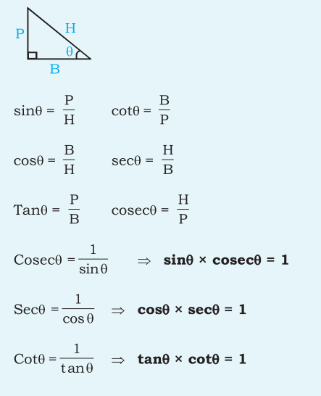
Basic Trigonometric Ratios :

Slide 5
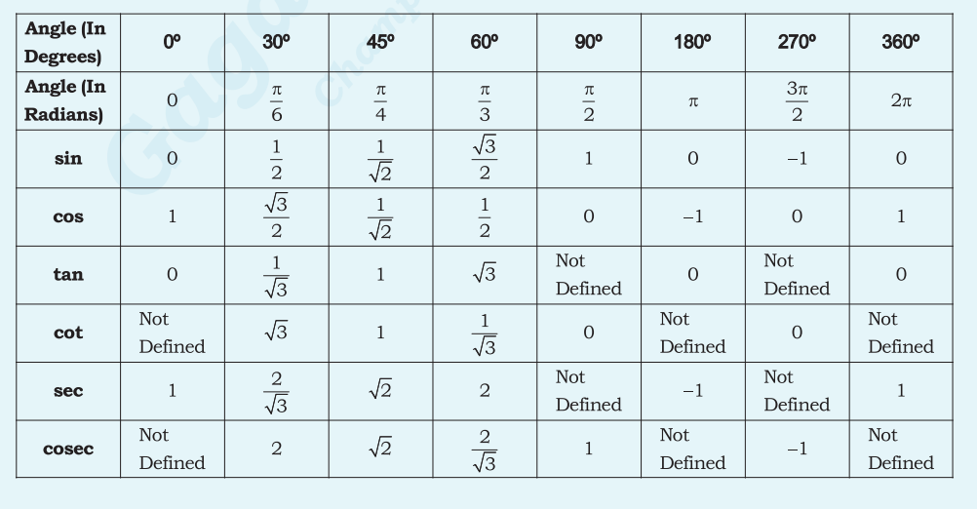
Trigonometry values

Slide 6
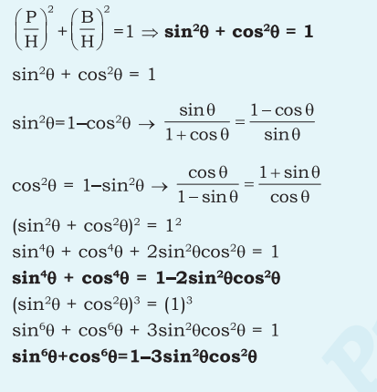
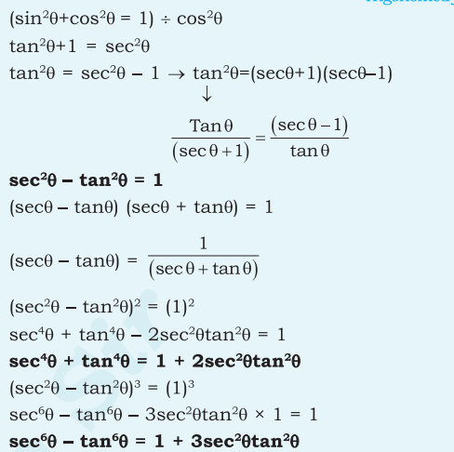
Trigonometric Identities :

Slide 7
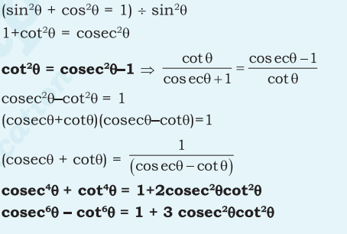
Trigonometric Identities :

Slide 8
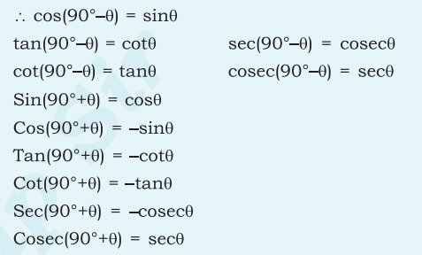
Trigonometric Identities :

Slide 9
QUESTION 1
If cosθ = 9/13, then what is the value of cosecθ?
13 / √𝟐𝟐
13√𝟐𝟐/ 44
2 √𝟐𝟐 / 13
√𝟐𝟐 / 13
Notes:
Ans-B

Slide 10
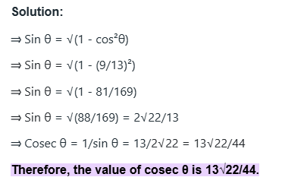

Slide 11
QUESTION 2
If 4cot A = 5, then what is the value of 6 sec A tan A?
𝟐𝟎√𝟒𝟏 / 21
𝟐𝟓√𝟒𝟏 / 24
23 √𝟒𝟏 / 2
𝟐𝟒√𝟒𝟏 / 𝟐5
Notes:
ANS-D

Slide 12
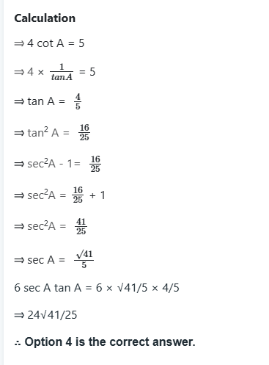

Slide 13
QUESTION 3
Find the value of 𝒄𝒐𝒕𝟏𝟏𝟏°√𝐬𝐞𝐜² 𝟏𝟏𝟏° − 1?
Cot²111°
1
Tan²21°
-1
Notes:
Ans-D
we know that sec²θ - 1 = tan²θ
so,
=cot²θ *√tan²θ
=cotθ * tanθ
=1

Slide 14
QUESTION 4
If tan(x+y) = 1 and cos(x–y) = √𝟑/𝟐, then what is the value of x and y?
x = 3, y = 4.5
x = 37.5, y = 7.5
X = 7.5, y = 37.5
x = 4.5, y =3
Notes:
ANS-B

Slide 15
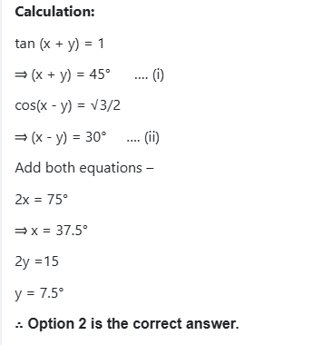

Slide 16
QUESTION 5
If Cotθ = 15 / 8 , θ is an acute angle, then find the value of ( 1 - cosθ ) * ( 2 + 2cosθ)/(2 - 2sinθ) *( 1 + sinθ).
16 / 15
225 / 64
8 / 15
64 / 225
Notes:
ANS-D

Slide 17
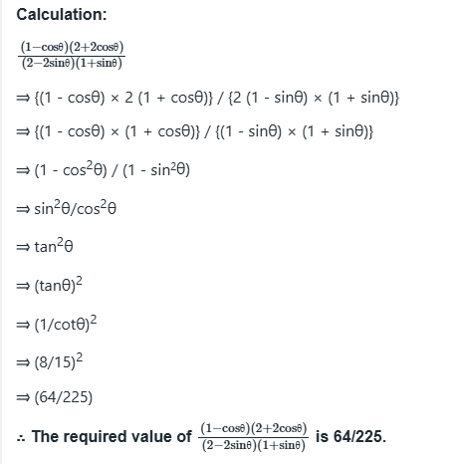

Slide 18
QUESTION 6
If sinθ + cosθ = √2 , then cosecθ + cotθ.
√2 – 1
√2 + 5
√3 - 1
√2 + 1
Notes:
ANS-D

Slide 19
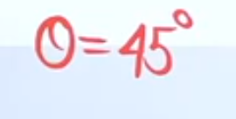
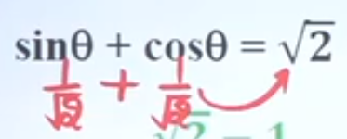
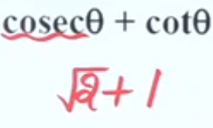
ANSWER

Slide 20
QUESTION 7
If Cotθ = √2+ 1 , then find the value of cosecθ x secθ?
√2 / 2
4√2
√2 / 4
2√2
Notes:
Ans: D) 2√2

Slide 21
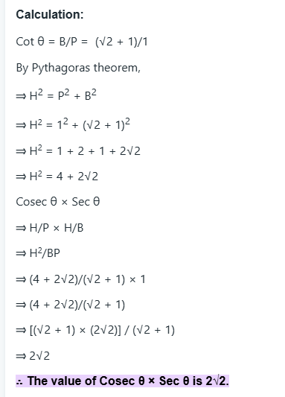
Notes:
H= HYPOTENUSE
P=OPPOSITE
B=BASE/ADJACENT

Slide 22
QUESTION 8
If cos 19° = a / b , then cosec 19° - cos 71° = ?
b² / a√a² - b²
a² / b√b² - a²
a²b² / √a² - b²
ab / √b² - a²
Notes:
Ans: B) a² / b√b² - a²

Slide 23
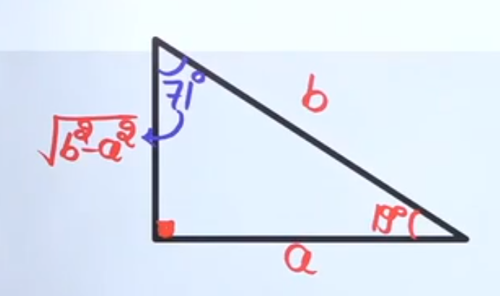
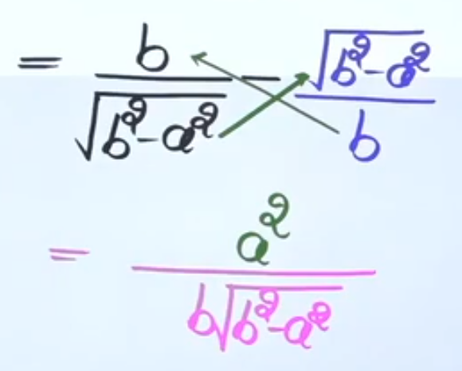
ANSWER

Slide 24
QUESTION 9
If 3tanθ = 2√3 sinθ , then 0° < θ < 90°, then the value of cosec² 2θ + cot² 2θ / sin² θ + tan² 2θ
20 / 39
4 / 13
4 / 3
20 / 27
Notes:
Ans: A) 20 / 39

Slide 25
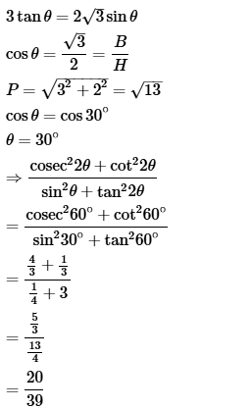

Slide 26
QUESTION 10
If sinθ = 2√ab / a+b , a > b > 0 , then the value of cosθ + 1 / cosθ - 1 will be:
- b / a
- a / b
a / b
b / a
Notes:
Ans: B) - a / b

Slide 27
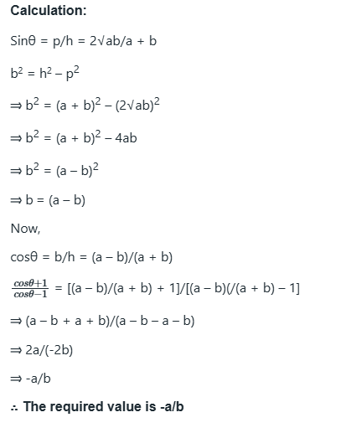

Slide 28
QUESTION 11
If (cosθ + sinθ) : ( cosθ - sinθ) = ( √3 + 1) : ( √3 - 1 ) , 0° < θ < 90° , then the value of secθ ?
2 √3 / 3
1
√2
2
Notes:
ANS-A

Slide 29
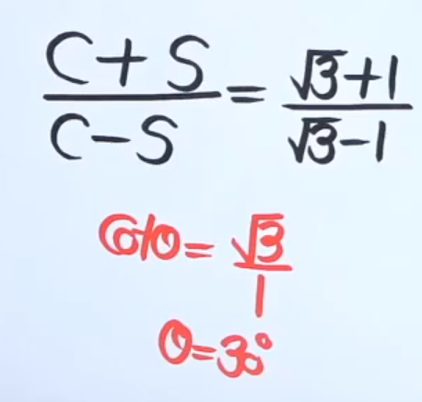
ANSWER

Slide 30
QUESTION 12
If Sinθ=√𝟏/ 6 √ 1 / 6 √ 1 / 6 − − − − − − − − − − − − − ∞ Then, tanθ+cotθ=?
36 / √ 35
36 / 35
√ 35 / 36
√ 35 / √ 36
Notes:
Ans: A) 36 / √ 35

Slide 31
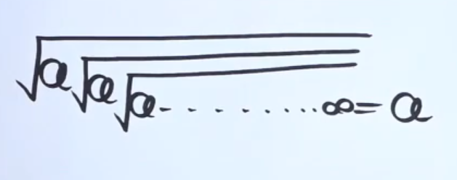
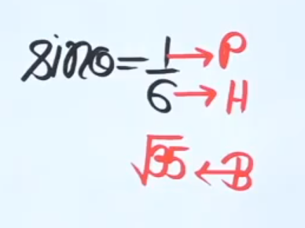
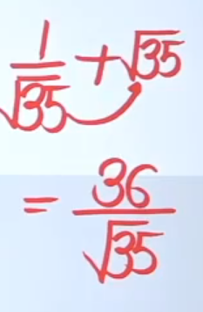
ANSWER

Slide 32
QUESTION 13
If 6 secθ = 10 , then find the value of (5 cosecθ - 3 cotθ ) / ( 4 cosθ + 3 sinθ).
2/3
3/2
5/6
6/5
Notes:
Ans: C) 5/6

Slide 33
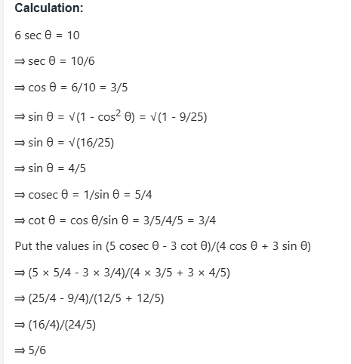

Slide 34
QUESTION 14
If cosecθ + cotθ / cosecθ - cotθ = 7 , then the value of 4 sin²θ + 5 / 4 sin²θ - 1 is:
15
3
9
12
Notes:
Ans: C) 9

Slide 35
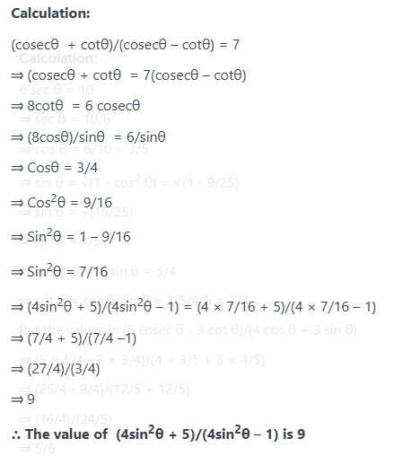

Slide 36
Question :
If cos 4x = sin x, where 0<x<90, what is the value of sin 5x?
Choices:
1
0
0.5
0.3
Notes:
Ans: a
cos⁡θ=sin⁡(90∘−θ)
cos⁡ 4x = sin⁡ x , this implies:
4x=90∘−x
5x=90∘
⇒x=18∘
sin⁡ 5x = sin⁡(5*18∘)
=sin⁡(90∘)
=1

Slide 37
If tan^4 θ + tan^2 θ = 1, then the value of cos^4 θ + cos^2 θ is ______.
○ 8
○ 10
○ 1
○ 2
Notes:
ANS: 1
Sec^2θ - Tan^2θ = 1
Sin^2 θ + Cos^2θ = 1
Calculation:
Tan^4θ + Tan^2θ = 1
= Tan^2θ (Tan^2θ + 1) = 1
{: sec^2θ = 1 + tan^2θ }
=(sin^2 θ /cos^4θ ) = 1
=1-cos^2θ = cos^4θ { :: sin^2θ = 1 – cos^2θ }
=cos^4θ + cos^2θ = 1
:. Then the value of cos^4θ + cos^2θ is 1.

Slide 38
Question
The number of solutions for 2 sin x + 3 cos x = 5 is ______.
○ 0
○ 1
○ 2
○ 3
Notes:
ANS: 0
The maximum value of sin x is 1.
The maximum value of cos x is 1.
Therefore, the maximum value of 2 sin x is 2.
The maximum value of 3 cos x is 3.
The maximum possible value of 2 sin x + 3 cos x is 2 + 3 = 5.
For the equation 2 sin x + 3 cos x = 5 to hold true, both sin x and cos x must achieve their maximum values simultaneously.
2 sin x must be 2, which implies sin x = 1.
3 cos x must be 3, which implies cos x = 1.
However, sin x and cos x cannot both be 1 at the same time.
If sin x = 1, then x = (2n + 1)π/2, where n is an integer.
If cos x = 1, then x = 2mπ, where m is an integer.
There is no value of x that satisfies both sin x = 1 and cos x = 1.
Since there is no value of x that satisfies the given equation, the number of solutions is 0.
The number of solutions for 2 sin x + 3 cos x = 5 is 0.

Slide 39
THANK YOU

